Slide 1
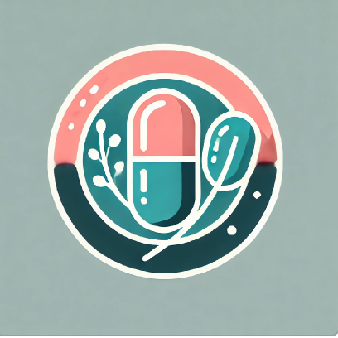
DATE 04/11/2025
NutraNail: Nutrient Deficiencies and Medical Information
Notes:
Hook: I am going to first start by asking everyone to look at their nails. Do you see white spots? Do you see brittleness, such as peeling around the nail line? You could be nutrient deficient. Symptoms include hair loss, fatigue, weakened immune system and depression
I introduce NutraNail, a phone application where you can…

Slide 2
Impact
Problem:
Lack of Awareness
Serious Health Effects
Simple Solutions:
Diet
Supplementation
Results:
Healthier, Happier lives
Notes:
Obviously a lack of awareness with obvious health effects. NutraNail will impact people by provide solutions, spreading awareness maintaining trust/Transparency/Confidentiality

Slide 3
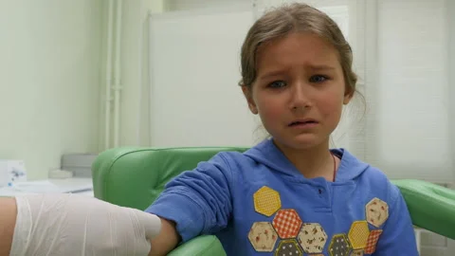
Current Solutions
Self-Diagnose
Inaccurate Information
72% of consumers prefer digital self-diagnosis tools before seeking medical care
Zoe
Personalized nutrition app secured $15 million investment to expand in the U.S.
(Image, HerrAntonio)
Potential: Diet and Nutrition App Global Market valued at $2.14 billion in 2024, projected $4.56 billion by 2030
(McKinsey Health Report, 2023)
(Grand View Research, 2024)
(The Times, 2024)
Notes:
Can worsen or create new Issues. Severe, expensive obvious symptoms arise and the damage has already been doe. Who likes getting a blood test? diet and nutrition app global market size Valued at USD 2.14 billion in 2024, projected to reach USD 4.56 billion by 2030, growing at a CAGR of 13.4%.

Slide 4
NutraNail
Solution
Users will upload close-up image
Image Classification with Transparent Results
Personalized Medical Information
Early Detection System
Accuracy and Trust
Actionable Solutions with Health Awareness

Slide 5
Target Market & Recap
Pregnant Women and Elderly:
Vitamin B12 Deficiency 27.5% of pregnant women globally
Only 42.5% over 71 meet adequate zinc intake levels in U.S.
Serious Health effects, solutions people want, targeting highly affected groups in a market with a lot of potential.
(WHO, 2024; PubMed, 2024)
(CDC, 2024)
Notes:
Pregnant Women & The Elderly Most at risk with Increased Effects. Serious Health effects, solutions people want, targeting highly affected groups in a market with a lot of potential.

Slide 6
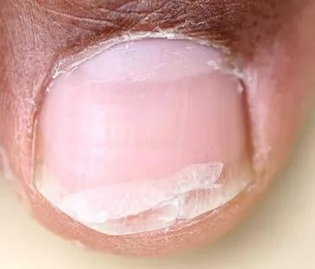
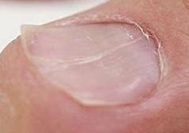
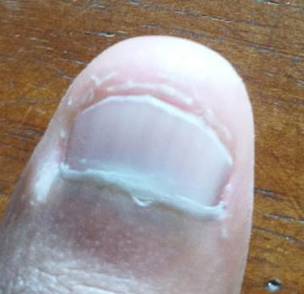
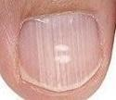
Problem Overview
Nuanced Classes
Biotin
brittle, splitting nails
Healthy
general damage
Iron
spoon shape, pale
Zinc
beau's lines, white spots
Notes:
Ridges (beau’s nails) ML: hard to differentiate with the naked eye, Each class has both shared and distinct visual cues, making feature extraction (color, ridges, shape) meaningful.

Slide 7
Preparing Data
Representative
Age
Gender
Race
Class Weights
Scikit-Learn
Manual
High Resolution
Close-up
Non-blurry
Data Augmentation
Realistic Images
fill_mode=’reflect’
Notes:
No blurry, duplicate images. Only high quality images of one nail through image scraping removing duplicate images. Class imbalance after image eye implemented class weights with manual after data augmentation. Small data set with Small realistic augmentations found reflect was best at filling empty or distorted space with a real image simulating another nail.

Slide 8
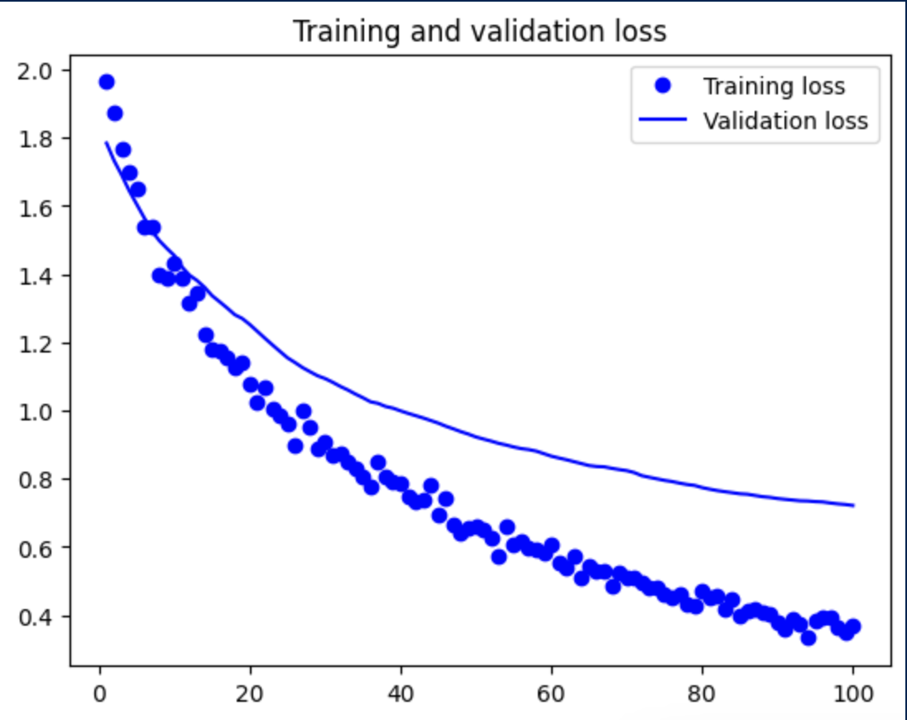
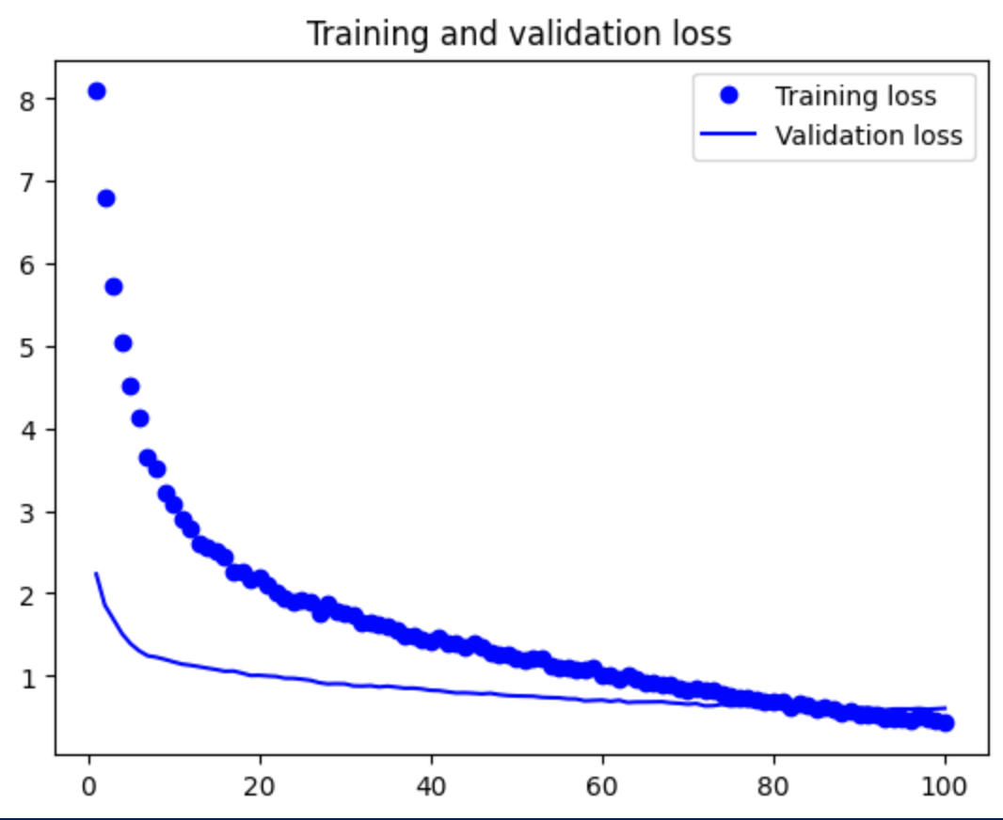
Regularization
Techniques
Overfitting vs. Dense Model
Small Data set
527 instances
Dropout
Not generalizable.
MaxPooling > AveragePooling
Discriminative
Prominent features
Notes:
Reduce overfitting vs building model dense enough to capture nuanced features. Some features found in training were not generalizable. Takes max of each feature map, more discriminative to strong signals, sensitive to important features.

Slide 9
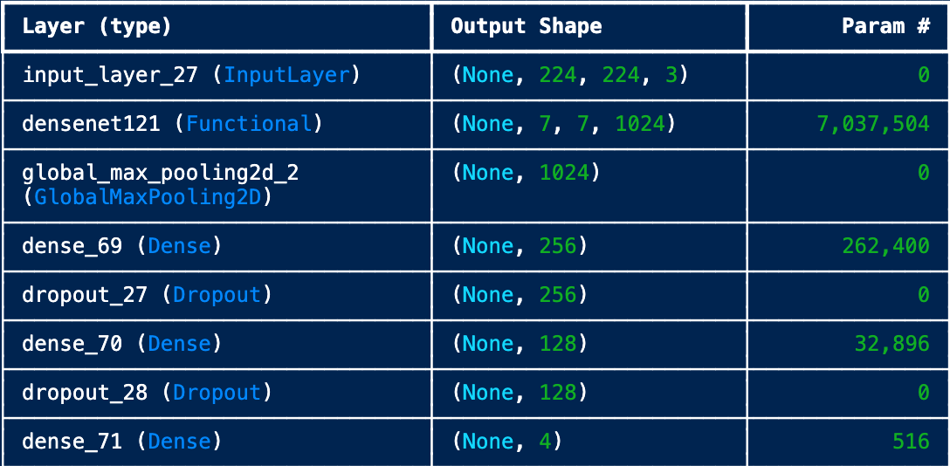
Feature Selection
Elu Activation
Subtle features
DenseNet121
Medical Imaging
Dense Connections
Feature Reuse
Gradient Flow
Fine-Tuning
Domain Specific Patterns
Notes:
Includes negatives unlike relu helpful when subtle features/patterns are important for classification. Subtle texture or color differences (common in nail images). Fine for nuanced classes.

Slide 10
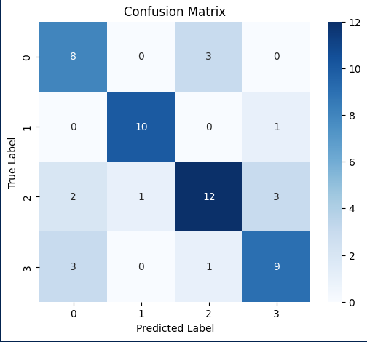
Final Model
Transfer Learning & Augmentation
Small Data Set
Nuanced Features
Slight Adjustments
Learning Rate Scheduler
Evaluation Set Accuracy: 80%
f1-score
Biotin: 76%
Healthy: 81%
Iron: 76%
Zinc: 83%
Notes:
Tranfer Learning + Data augmentation: solved small data set non representative with very subtle and important feature selection. Dropout, GlobalMaxPooling, class_weights, Unfrozen Layers, Dropout, and a learning rate scheduler to decrease overfitting near end of training.

Slide 11
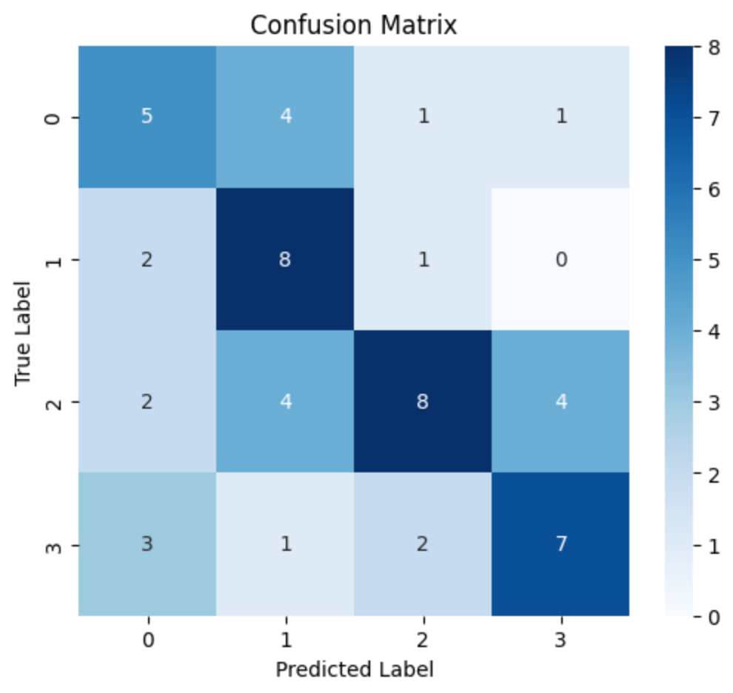
Baseline Accuracies
Random Guess Accuracy: 26%
Human-Level Performance: 60%
Biotin: 62%
Healthy: 70%
Iron: 42%
Zinc: 66%
Basic Multilayer Perceptron: 56.5%
f1-score
Biotin: 38%
Healthy: 64%
Iron: 56%
Zinc: 61%
Notes:
Healthy Nails are relatively easy to classify. Due to differences in class performance, it was important to see fine grained feature extraction of CNNs.

Slide 12
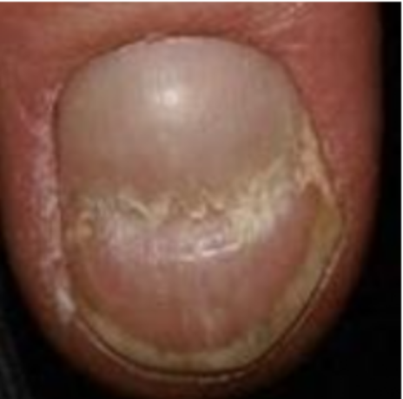
Error Analysis
Inter-Class Similarity 6/12: 50%
Ridges Irregular Textures
Solution: Train more instances of Subtle Deficiencies
Data Set Noise 5/12: 42%
Labeling/Quality/Lighting
Solution: More Representative, Clean data
Notes:
Ridges and Irregular Textures shown in both iron and zinc. Less extreme nutrient deficiency were unrealistic and less generalizable. More slight deficiencies. It is very important the model is able to classify subtle deficiencies because these are early stages of the more severe cases (catching these cases would decrease the amount of severe cases).

Slide 13
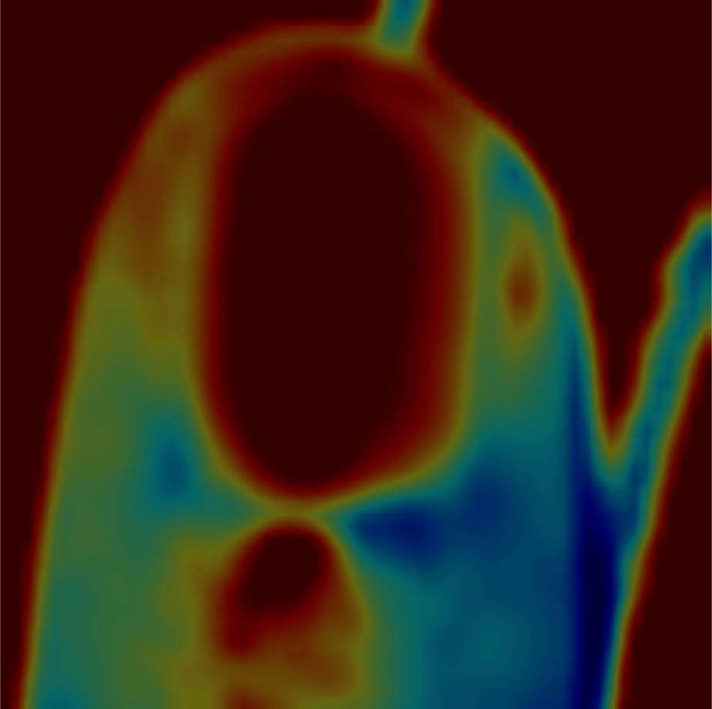
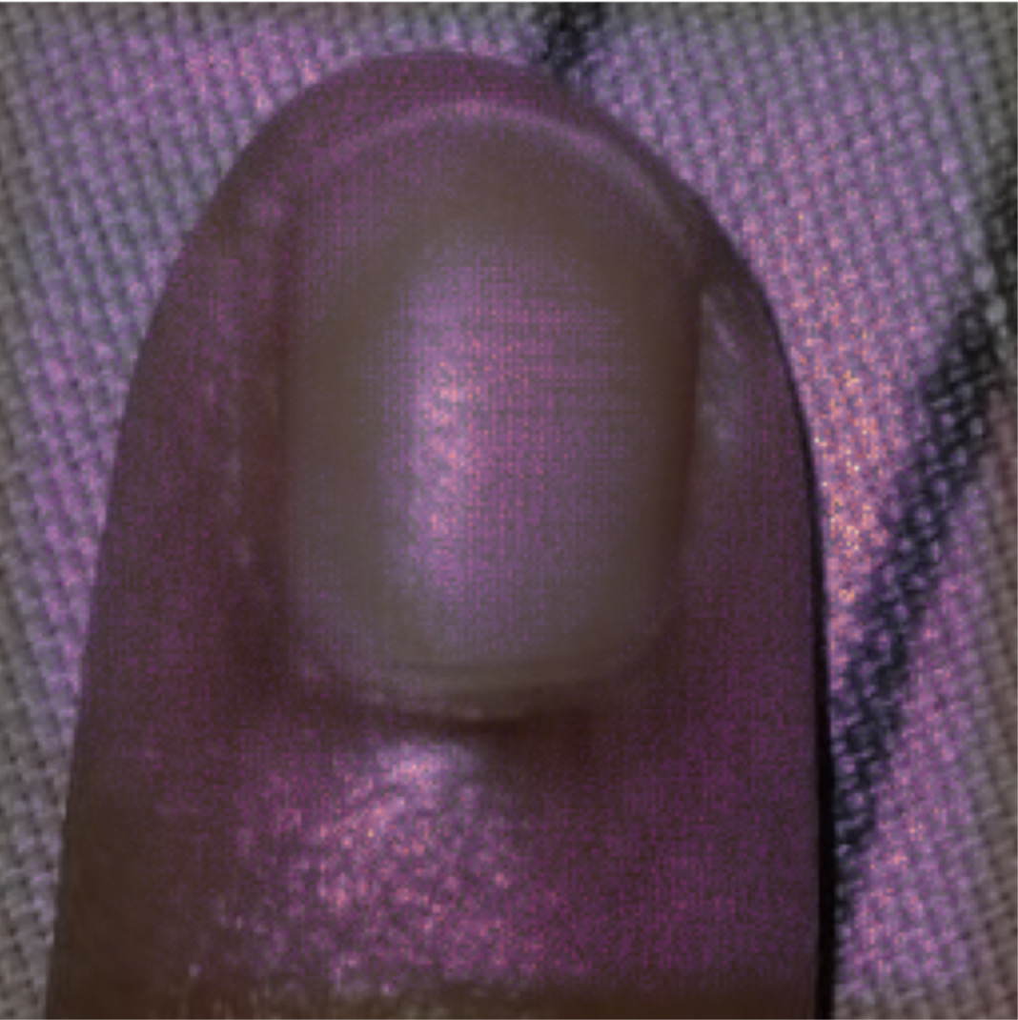
Explainable AI
Grad-Cam
Region Heat Maps
Difficult to analyze
Integrated Gradients
Pixel Level
Fine Grained
Notes:
Subtle nuances like ridges or discoloration.

Slide 14
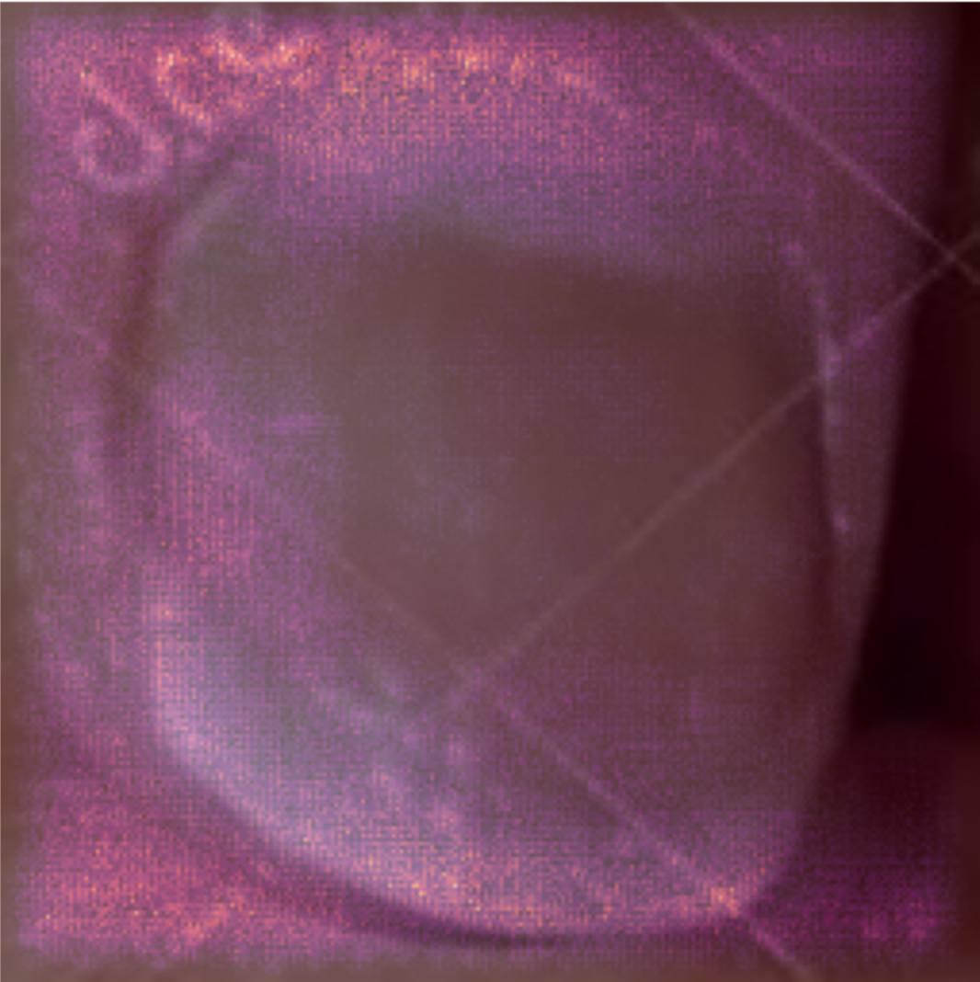
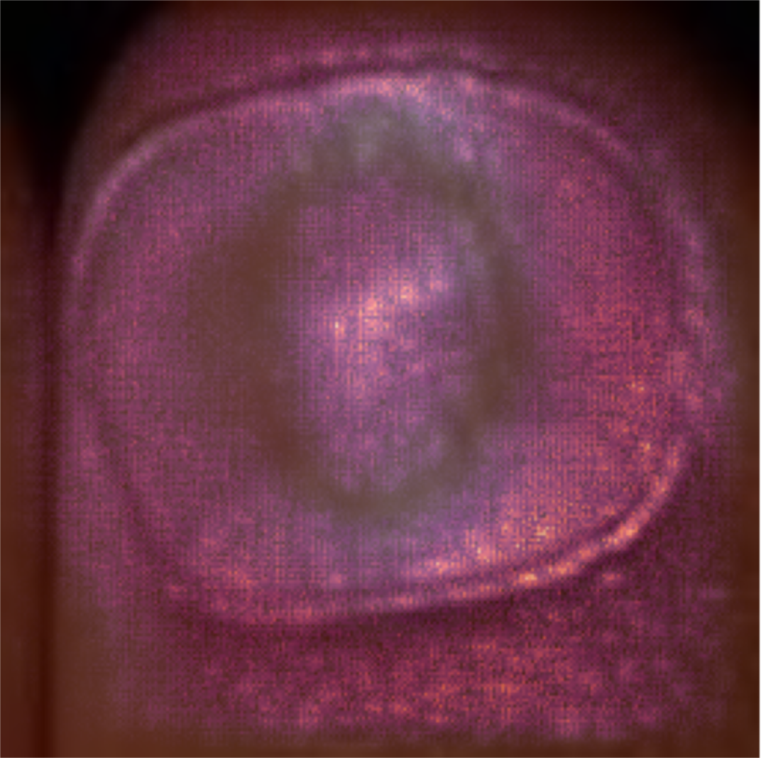
Explainable AI
Solutions:
Data Cleaning
Cropping/Lighting
Stronger Augmentation
Custom Loss Function
Feedback Loop
In-App Feature
Notes:
Misclassifications were caused by training on background or noise (lighting or watermarks)

Slide 15
Think Aloud
A/B Test
Simplicity
Personalized Results
Transparency & Disclaimers
Premium Account
Valued Features
Lacked Presentation
Free vs Paid Account:
Understanding App Structure
Easier to Navigate
More likely to understand and consider premium features
Notes:
Valued premium features but presentation

Slide 16
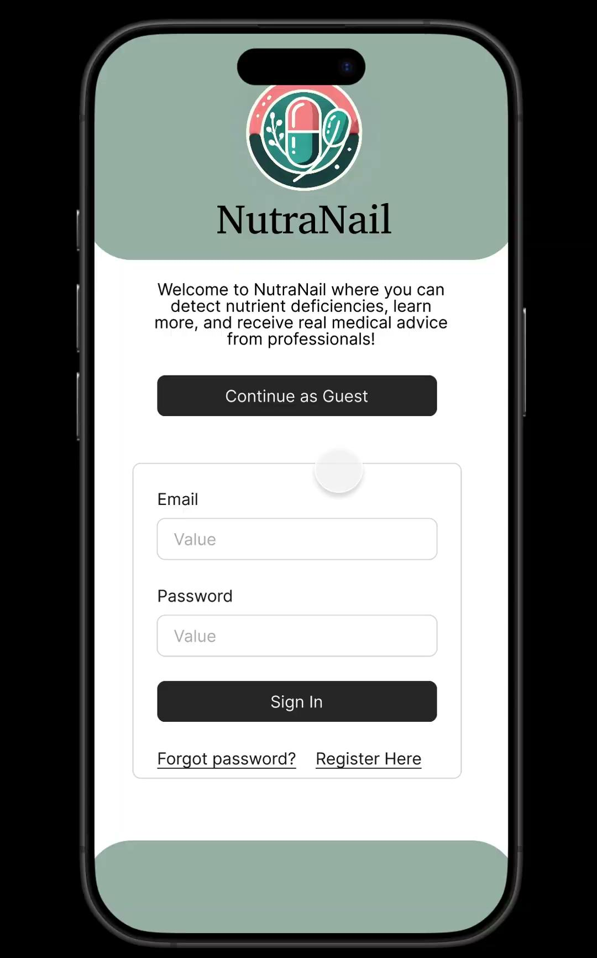
Notes:
Includes negative helpful when subtle features/patterns are important for classification. Subtle texture or color differences (common in nail images). Fine for nuanced classes.exture or color

Slide 17
NutraNail

